Slide 1
Data Link Layer and Medium Access Sub Layer
Error Detection and Error Correction
Fundamentals
Block coding
Hamming Distance
CRC
Flow Control and Error control protocols
Stop and Wait
Go back – N ARQ
Selective Repeat ARQ
Sliding Window
Piggybacking
Random Access, Multiple access protocols
Pure ALOHA
Slotted ALOHA
CSMA/CD
CDMA/CA

Slide 2
Responsibilities of the data link layer include framing, addressing, flow control, error control, and media access control
The data link layer divides the stream of bits received from the network layer into manageable data units called frames.
The data link layer adds a header to the frame to define the addresses of the sender and receiver of the frame.
Imposes a flow control mechanism to avoid flooding of data at the receiver.
Adds reliability to the physical layer by adding mechanisms to detect and retransmit damaged, duplicate, or lost frames.
When two or more devices are connected to the same link, data link layer protocols are necessary to determine which device has control over the link at any given time.

Slide 3
Design issues with data link layer are
Services provided to the network layer
Frame synchronization
Flow control
Error control
Services provided to the network layer
It provides three types of services:
Unacknowledged and connectionless services.
Acknowledged and connectionless services.
Acknowledged and connection-oriented services

Slide 4
Unacknowledged and connectionless services.
Here the sender machine sends the independent frames without any acknowledgement from the sender.
There is no logical connection established.
Acknowledged and connectionless services.
There is no logical connection between sender and receiver established.
Each frame is acknowledged by the receiver.
If the frame didn’t reach the receiver in a specific time interval it has to be sent again.
It is very useful in wireless systems.
Acknowledged and connection-oriented services
A logical connection is established between sender and receiver before data is trimester.
Each frame is numbered so the receiver can ensure all frames have arrived and exactly once.

Slide 5
Frame Synchronization
The source machine sends data in the form of blocks called frames to the destination machine. The starting and ending of each frame should be identified so that the frame can be recognized by the destination machine.
Flow control Flow control is done to prevent the flow of data frame at the receiver end. The source machine must not send data frames at a rate faster than the capacity of destination machine to accept them.
Error control Error control is done to prevent duplication of frames. The errors introduced during transmission from source to destination machines must be detected and corrected at the destination machine.

Slide 6
Various kind of Framing in Data link layer
The data link layer is responsible for Framing, which is the division of stream of bits from network layer into manageable units (called frames).
Frames could be of fixed size or variable size.
In variable-size framing, we need a way to define the end of the frame and the beginning of the next frame.
Frames are generally data unit of data link layer that is transmitted among various network points. It includes complete and full addressing, protocols that are essential, and information under control. Physical layers only just accept and transfer stream of bits without any regard to meaning or structure. Therefore it is up to data link layer to simply develop and recognize frame boundaries.
This can be achieved by attaching special types of bit patterns to start and end of the frame. If all of these bit patterns might accidentally occur in data, special care is needed to be taken to simply make sure that these bit patterns are not interpreted incorrectly or wrong as frame delimiters.
Character count
Flag Byte with character stuffing
Starting and Ending flags , with bit stuffing

Slide 7
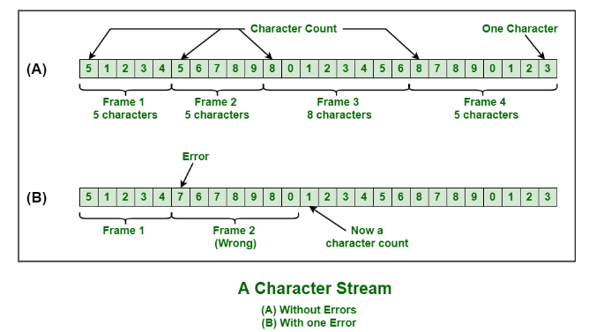
Character Count
This method is rarely used and is generally required to count total number of characters that are present in frame. This is done by using field in header.
Character count method ensures data link layer at the receiver or destination about total number of characters that follow, and about where the frame ends.
There is disadvantage also of using this method i.e., if anyhow character count is disturbed or distorted by an error occurring during transmission, then destination or receiver might lose synchronization.
The destination or receiver might also be not able to locate or identify beginning of next frame.

Slide 8
Character Stuffing:
Character stuffing is also known as byte stuffing or character-oriented framing and is same as that of bit stuffing but byte stuffing actually operates on bytes whereas bit stuffing operates on bits.
In byte stuffing, special byte that is basically known as ESC (Escape Character) that has predefined pattern is generally added to data section of the data stream or frame when there is message or character that has same pattern as that of flag byte.
But receiver removes this ESC and keeps data part that causes some problems or issues.
In simple words, we can say that character stuffing is addition of 1 additional byte if there is presence of ESC or flag in text.

Slide 9
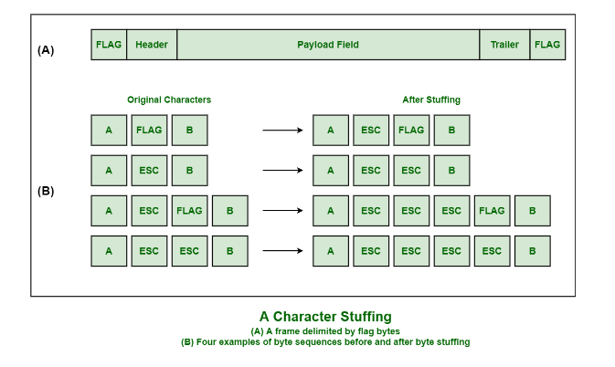

Slide 10
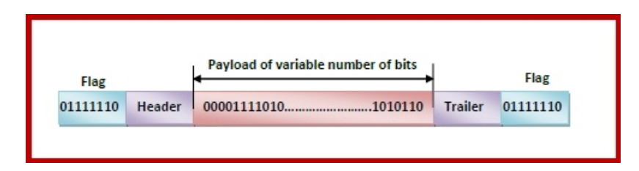
Frame in a Bit - Oriented Protocol
In bit-oriented protocols, the message is coded as a sequence of bits, which are interpreted in the upper layers as text, graphics, audio, video etc. A frame has the following parts −
Frame Header − It contains the source and the destination addresses of the frame.
Payload field − It contains the message to be delivered.
Trailer − It contains the error detection and error correction bits.
Flags − A bit pattern that defines the beginning and end bits in a frame. It is generally of 8-bits. Most protocols use the 8-bit pattern 01111110 as flag.

Slide 11
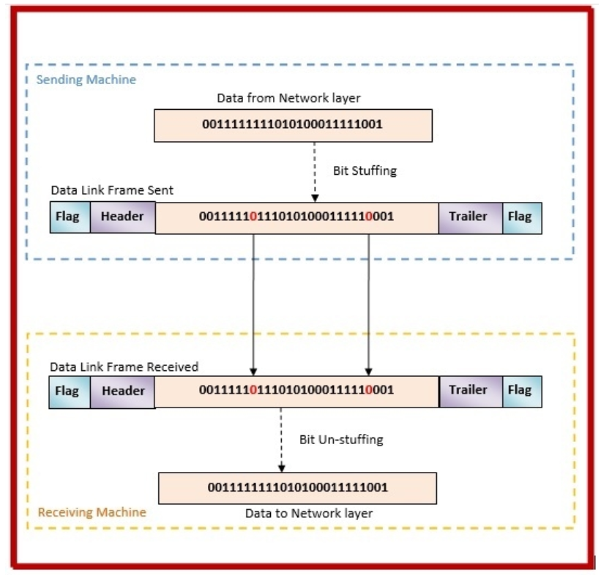
Bit Stuffing Mechanism
In a data link frame, the delimiting flag sequence generally contains six or more consecutive 1s. In order to differentiate the message from the flag in case of the same sequence, a single bit is stuffed in the message. Whenever a 0 bit is followed by five consecutive 1bits in the message, an extra 0 bit is stuffed at the end of the five 1s.
When the receiver receives the message, it removes the stuffed 0s after each sequence of five 1s. The un-stuffed message is then sent to the upper layers.

Slide 12
Fundamentals
Error is a condition when the receiver’s information does not match the sender’s information. During transmission, digital signals suffer from noise that can introduce errors in the binary bits traveling from sender to receiver. That means a 0 bit may change to 1 or a 1 bit may change to 0.
Data may get scrambled by noise or get corrupted whenever a message is transmitted. To prevent such errors, error-detection codes are added as extra data to digital messages. This helps in detecting any errors that may have occurred during message transmission.
Types of Errors
Single bit error
Burst error

Slide 13
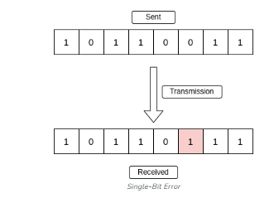
Single-Bit Error
A single-bit error refers to a type of data transmission error that occurs when one bit (i.e., a single binary digit) of a transmitted data unit is altered during transmission, resulting in an incorrect or corrupted data unit.

Slide 14
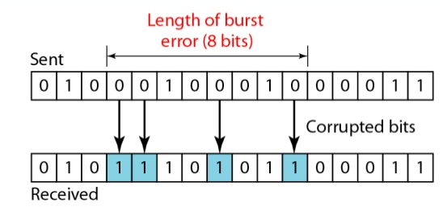
Burst Error
A burst error means that 2 or more bits in the data unit have changed.

Slide 15
Redundancy
The central concept in detecting or correcting errors is redundancy. To be able to detect or correct errors, we need to send some extra bits with our data. These redundant bits are added by the sender and removed by the receiver. Their presence allows the receiver to detect or correct corrupted bits.
Detection Versus Correction
In error detection, we are looking only to see if any error has occurred. The answer is a simple yes or no.
In error correction, we need to know the exact number of bits that are corrupted and more importantly, their location in the message. The number of the errors and the size of the message are important factors. If we need to correct one single error in an 8-bit data unit, we need to consider eight possible error locations

Slide 16
Forward Error Correction Versus Retransmission
There are two main methods of error correction.
Forward error correction is the process in which the receiver tries to guess the message by using redundant bits. This is possible if the number of errors is small.
Correction by retransmission is a technique in which the receiver detects the occurrence of an error and asks the sender to resend the message. Resending is repeated until a message arrives that the receiver believes is error-free.

Slide 17
Coding
Redundancy is achieved through various coding schemes. The sender adds redundant bits through a process that creates a relationship between the redundant bits and the actual data bits. The receiver checks the relationships between the two sets of bits to detect or correct the errors.
The coding schemes are divided into two broad categories:
block coding
convolution coding

Slide 18
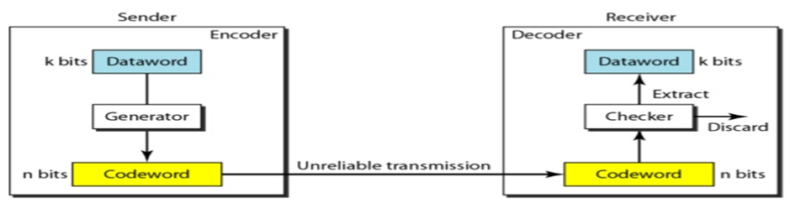
BLOCK CODING
In block coding, message is divided into blocks, each of k bits, called data words. add r redundant bits to each block to make the length n = k + r. The resulting n-bit blocks are called code words.

Slide 19
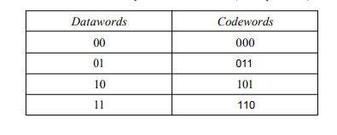
Error Detection
Ex : Let us assume that k =2 and n =3. Below Table shows the list of datawords and codewords. Later, we will see how to derive a codeword from a dataword
Assume the sender encodes the dataword 01 as 011 and sends it to the receiver.
Consider the following cases:
The receiver receives 011. It is a valid codeword. The receiver extracts the dataword 01 from it.
The codeword is corrupted during transmission, and 111 is received (the leftmost bit is corrupted). This is not a valid codeword and is discarded.

Slide 20
3. The codeword is corrupted during transmission, and 000 is received (the right two bits are corrupted). This is a valid codeword. The receiver incorrectly extracts the dataword 00. Two corrupted bits have made the error undetectable.
Note: An error-detecting code can detect only the types of errors for which it is designed; other types of errors may remain undetected.

Slide 21
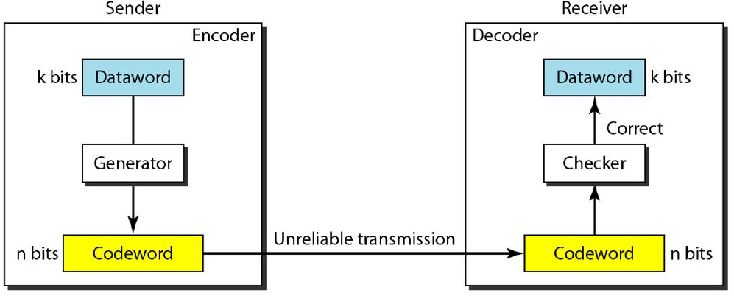
Error Correction
Error correction is difficult than error detection. In error detection, the receiver needs to know only that the received code word is invalid; in error correction the receiver needs to find the original code word sent.

Slide 22
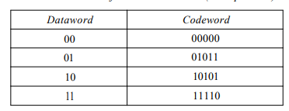
Example :Add more redundant bits to previous example to see if the receiver can correct an error without knowing what was actually sent. We add 3 redundant bits to the 2-bit dataword to make 5-bit codewords.
Assume the dataword is 01. The sender consults the table (or uses an algorithm) to create the codeword 01011.
Assume that the codeword is corrupted during transmission, and 01001 is received (error in the second bit from the right).
First, the receiver finds that the received codeword is not in the table. This means an error has occurred.
Error Detection is done

Slide 23
. The receiver, assuming that there is only 1 bit corrupted, uses the following strategy to guess the correct dataword
Comparing the received codeword with the first codeword in the table (01001 versus 00000), the receiver decides that the first codeword is not the one that was sent because there are two different bits.
2. By the same reasoning, the original codeword cannot be the third or fourth one in the table.
3. The original codeword must be the second one in the table because this is the only one that differs from the received codeword by 1 bit. The receiver replaces 01001 with 01011 and consults the table to find the dataword 01.

Slide 24
Hamming Distance
One of the central concepts in coding for error control is the idea of the Hamming distance. The Hamming distance between two words (of the same size) is the number of differences between the corresponding bits.
The Hamming distance between x and y can be shown as d(x, y).
The Hamming distance can easily be found if we apply the XOR operation on the two words and count the number of 1s in the result. Note that the Hamming distance is a value greater than zero.
Example: Hamming distance between two pairs of words.
The Hamming distance d(000, 011) is 2 because 000 XOR 011 is 011 (two Is).
The Hamming distance d(10101, 11110) is 3 because 10101 XOR 11110 is 01011 (three 1s).

Slide 25
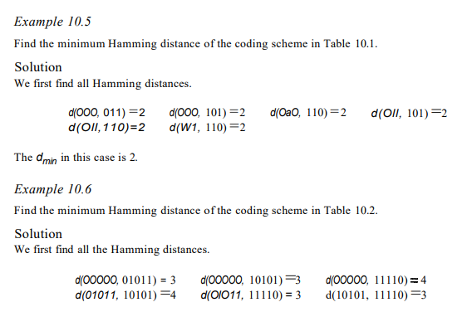
Minimum Hamming Distance
The minimum Hamming distance is the smallest Hamming distance between all possible pairs in a set of words

Slide 26
Any coding scheme needs to have at least three parameters:
the dataword size k
the codeword size n
the minimum Hamming distance dmin.
A coding scheme C is written as C(n, k) with a separate expression for dmin
Example: we can call our first coding scheme C(3, 2) with dmin =2 and our second coding scheme C(5, 2) with dmin := 3.
Hamming Distance and Error
Relationship between the Hamming distance and errors
When a codeword is corrupted during transmission, the Hamming distance between the sent and received codewords is the number of bits affected by the error.
Example: If the codeword 00000 is sent and 01101 is received, 3 bits are in error and the Hamming distance between the two is d(OOOOO, 01101) =3.

Slide 27
LINEAR BLOCK CODES
All block codes used today belong to a subset called linear block codes.
use of nonlinear block codes for error detection and correction is not as widespread because their structure makes theoretical analysis and implementation difficult.
A linear block code is a code in which the exclusive OR (addition modulo-2) of two valid code-words creates another valid code-word.
Simple to find the minimum Hamming distance for a linear block code.
Example:

Slide 28
Simple Parity-Check Code
In this code, a k-bit dataword is changed to an n-bit codeword
where n = k + 1. The extra bit, called the parity bit, is selected to make the total number of 1s in the codeword even/odd.
Here we use even number parity bit concept.
The minimum Hamming distance for this category is dmin =2, which means that the code is a single-bit error-detecting code
It is referred as least expensive method

Slide 29
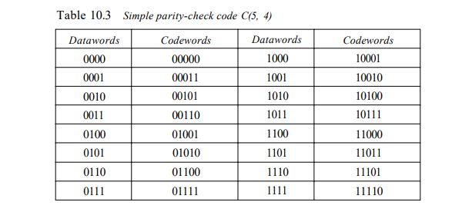

Slide 30
Two-Dimensional Parity Check
Here dataword is organized in a table (rows and columns).
For each row and each column, 1 parity-check bit is calculated.
The whole table is then sent to the receiver. The two-dimensional parity check can detect up to three errors that occur anywhere in the table.
However, errors affecting 4 bits may not be detected.

Slide 31
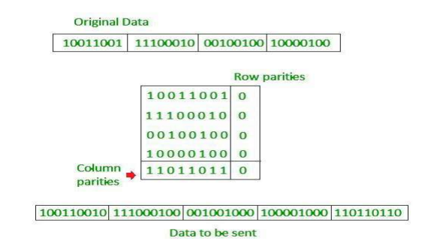

Slide 32
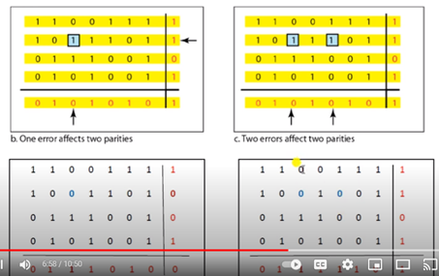

Slide 33
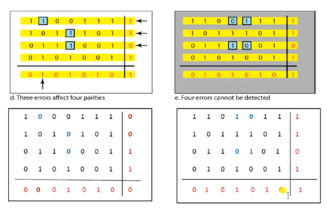

Slide 34
CYCLIC CODES:
Cyclic codes are special linear block codes with one extra property.
In a cyclic code, if a code-word is cyclically shifted (rotated), the result is another code-word.
For example, if 1011000 is a codeword and we cyclically left-shift, then 0110001 is also a codeword.

Slide 35
Cyclic Redundancy Check
It comes under the category of cyclic codes
Here the encoder, the dataword has k bits,the codeword has n bits.
The size of the dataword is augmented by adding n - k 0s to the right-hand side of the word.
The n-bit result is fed into the generator.
The generator uses a divisor of size n - k + 1, predefined and agreed upon.
The generator divides the augmented dataword by the divisor (modulo-2 division).
The quotient of the division is discarded; the remainder is appended to the dataword to create the codeword.

Slide 36
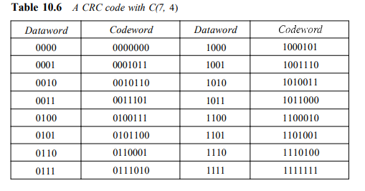

Slide 37
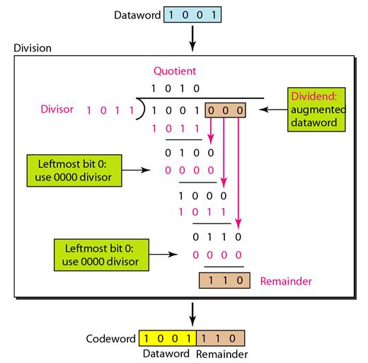

Slide 38
Decoder :
The decoder receives the possibly corrupted codeword.
A copy of all n bits is fed to the checker which is a replica of the generator. The remainder produced by the checker is a syndrome of n - k bits, which is fed to the decision logic analyzer.
The anayzer has a simple function.
If the syndrome bits are all 0s, the 4 leftmost bits of the codeword are accepted as the dataword (interpreted as no error); otherwise, the 4 bits are discarded (error).

Slide 39
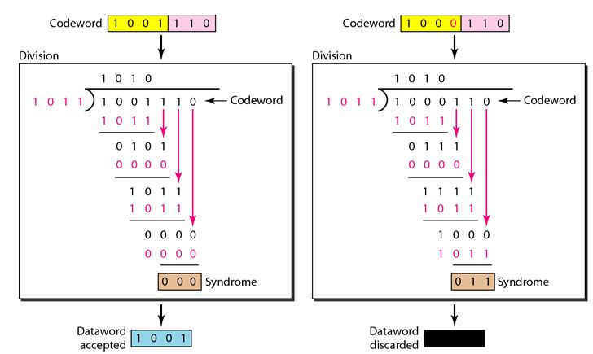

Slide 40
Checksum
In checksum error detection scheme, the data is divided into k segments each of m bits.
In the sender’s end the segments are added using 1’s complement arithmetic to get the sum.
The sum is complemented to get the checksum.
The checksum segment is sent along with the data segments.
At the receiver’s end, all received segments are added using 1’s complement arithmetic to get the sum.
The sum is complemented.
If the result is zero, the received data is accepted; otherwise discarded.

Slide 41
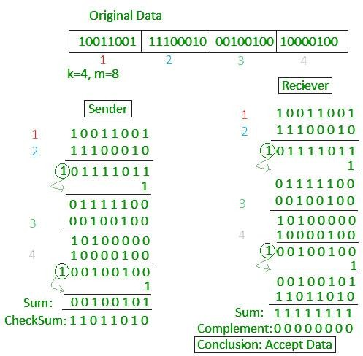

Slide 42
Flow Control and Error control protocols
Stop and Wait
Go back – N ARQ
Selective Repeat ARQ
Sliding Window
Piggybacking

Slide 43
Data Link Control
Data Link Control and Media Access Control
Data link control, deals with the design and procedures for communication between two adjacent nodes.
Media access control, deals with how to share the link.

Slide 44
Data link control include
Framing,
Flow and error control
software implemented protocols that provide smooth and reliable transmission of frames between nodes.

Slide 45
To implement data link control, we need protocols.
Each protocol is a set of rules that need to be implemented in software and run by the two nodes involved in data exchange at the data link layer.
There are five protocols here
Two for noiseless (ideal) channels and Three for noisy (real) channels.
Those in the first category are not actually implemented, but provide a foundation for understanding the protocols in the second category.

Slide 46
FRAMING
The data link layer pack bits into frames, so that each frame is distinguishable from another.
The destination address defines where the packet is to go; the sender address helps the recipient acknowledge the receipt.
The whole message could be packed in one frame, that is not normally done. One reason is that a frame can be very large, making flow and error control very inefficient.
When a message is carried in one very large frame, even a single-bit error would require the retransmission of the whole message.
When a message is divided into smaller frames, a single-bit error affects only that small frame.
Frames can be of fixed or variable size.

Slide 47
Fixed size framing
In fixed-size framing, there is no need for defining the boundaries of the frames; the size itself can be used as a delimiter.
Variable-Size Framing
In variable-size framing, we need a way to define the end of the frame and the beginning of the next.
Two approaches were used for this purpose:
character-oriented approach
bit-oriented approach

Slide 48
Character-Oriented
In a character-oriented approach, data to be carried are 8-bit characters from a coding system such as ASCII .
Character-oriented framing was popular when only text was exchanged by the data link layers.
The header carries the source and destination addresses and other control information, and the trailer, which carries error detection or error correction redundant bits, are also multiples of 8 bits.
To separate one frame from the next, an 8-bit (I-byte) flag is added at the beginning and the end of a frame. The flag, composed of protocol-dependent special characters, signals the start or end of a frame.

Slide 49
If this happens, the receiver, when it encounters this pattern in the middle of the data, thinks it has reached the end of the frame.
To fix this problem, a byte-stuffing strategy was added to character-oriented framing. a special byte is added to the data section of the frame when there is a character with the same pattern as the flag. The data section is stuffed with an extra byte.
This byte is usually called the escape character (ESC), which has a predefined bit pattern.
What happens if the text contains one or more escape characters followed by a flag?

Slide 50
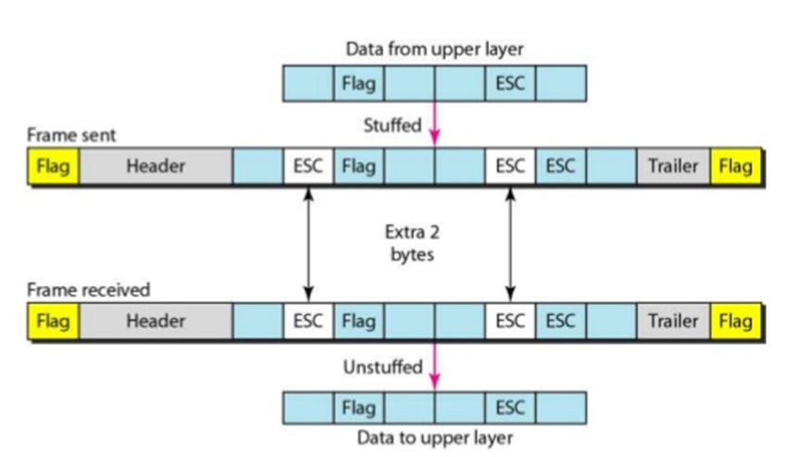
This approach faces a problem. The universal coding systems in use today, such as Unicode, have 16-bit and 32-bit characters that conflict with 8-bit characters. Hence, there is a tendency to move towards the bit-oriented protocols

Slide 51
Byte stuffing is the process of adding 1 extra byte whenever there is a flag or escape character in the text.

Slide 52
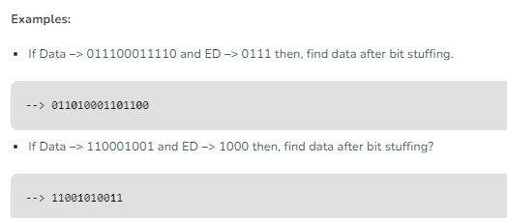
Bit-Oriented
Bit Stuffing: Let ED = 01111 and if data = 01111 Sender stuffs a bit to break the pattern i.e. here appends a 0 in data = 011101. Receiver receives the frame. If data contains 011101, receiver removes the 0 and reads the data.

Slide 53
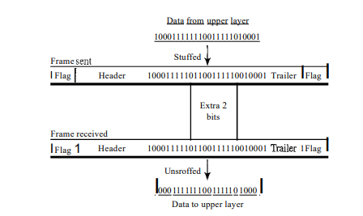
This means that if the flag like pattern 01111110 appears in the data, it will change to 011111010 (stuffed) and is not mistaken as a flag by the receiver. The real flag 01111110 is not stuffed by the sender and is recognized by the receiver
Bit stuffing is the process of adding one extra 0 whenever five consecutive 1s follow a 0 in the data, so that the receiver does not mistake the pattern 0111110 for a flag.

Slide 54
Flow and error control
Flow control
Flow control is a set of procedures that tells the sender how much data it can transmit before it must wait for an acknowledgment from the receiver.
Any receiving device has a limited speed for process incoming data and a limited amount of memory to store incoming data.
The receiving device must be able to inform the sending device before those limits are reached .
Incoming data must be checked and processed before they can be used.
Each receiving device has a block of memory, called a buffer, reserved for storing incoming data until they are processed.

Slide 55
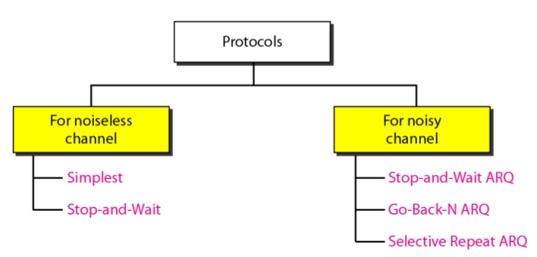
The protocols are normally implemented in software by using one of the common programming languages.
Protocols are divided into those that can be used for noiseless (error-free) channels and those that can be used for noisy (error-creating) channels.

Slide 56
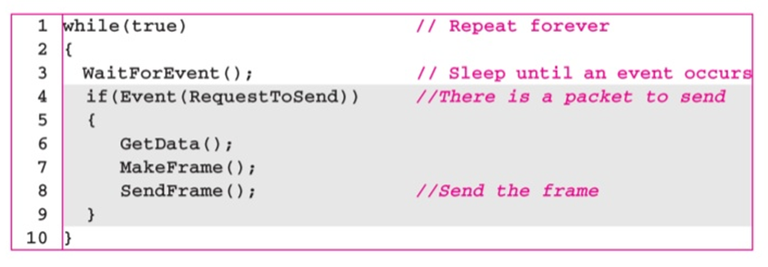
Simplex protocol
The first protocol is called Simplest Protocol that has no flow or error control.
It is a unidirectional protocol in which data frames are traveling in only one direction-from the sender to receiver.
Receiver can immediately handle any frame it receives with a processing time that is small enough to be negligible.
The data link layer of the receiver immediately removes the header from the frame and hands the data packet to its network layer, which can also accept the packet immediately.

Slide 57
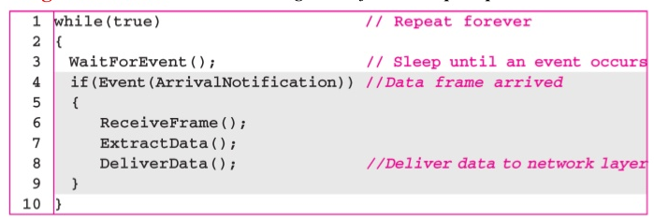

Slide 58
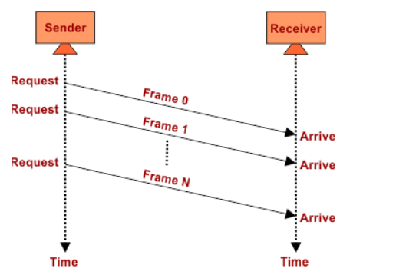
Flow diagram

Slide 59
Stop-and-Wait Protocol
The primitives of stop and wait protocol are:
Sender side
Rule 1: Sender sends one data packet at a time.
Rule 2: Sender sends the next packet only when it receives the acknowledgment of the previous packet.
Therefore, the idea of stop and wait protocol in the sender's side is very simple, i.e., send one packet at a time, and do not send another packet before receiving the acknowledgment.

Slide 60
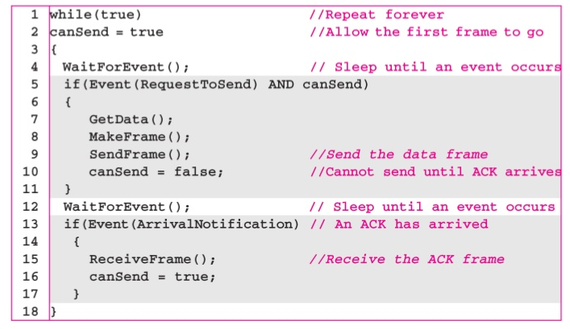
Data Link Control- Stop-and-Wait Protocol
At Sender Site

Slide 61
Receiver side
Rule 1: Receive and then consume the data packet.
Rule 2: When the data packet is consumed, receiver sends the acknowledgment to the sender.
Therefore, the idea of stop and wait protocol in the receiver's side is also very simple, i.e., consume the packet, and once the packet is consumed, the acknowledgment is sent. This is known as a flow control mechanism.

Slide 62
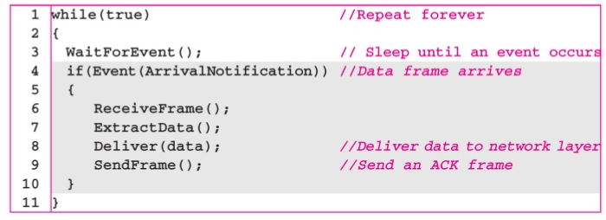
Data Link Control- Stop-and-Wait Protocol
At Receiver site

Slide 63
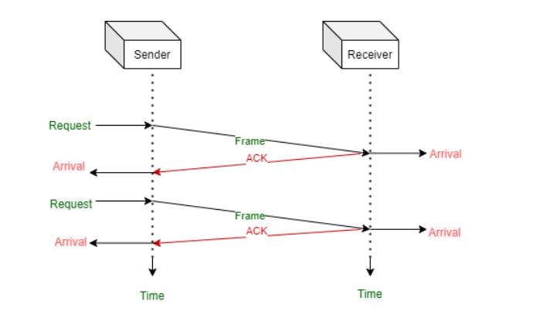
Flow diagram

Slide 64
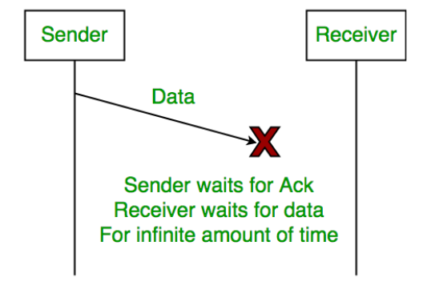
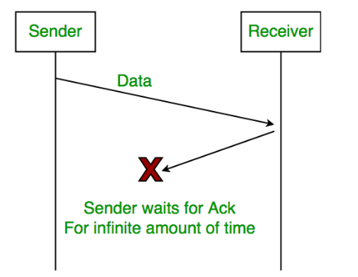
Problems Associated with Stop and Wait
Lost data
2. Lost acknowledgement

Slide 65
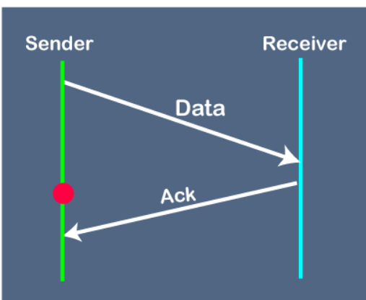
3. Delayed acknowledgement

Slide 66
Noisy Channels – Protocols
1) Stop-and-Wait Automatic Repeat Request
Its an improved and modified version of stop and wait protocol.
Stop and Wait ARQ assumes
The communication channel is noisy.
Errors may get introduced in the data during the transmission.
Working-
Stop and wait ARQ works similar to stop and wait protocol.
It provides a solution to all the limitations of stop and wait protocol.
Stop and wait ARQ includes the following three extra elements.

Slide 67
Extra elements in stop and wait ARQ
Time out timer
Sequence number for data packets
Sequence number for acknowledgements
Stop and Wait ARQ
= Stop and Wait Protocol + Time Out Timer + Sequence Numbers for Data Packets +Sequence Numbers of Acknowledgements
Number of Sequence Numbers Required-
Available Sequence Numbers >= Sender Window Size + Receiver Window Size

Slide 68
Stop and wait ARQ is a one bit sliding window protocol where-
Sender window size = 1
Receiver window size = 1
Thus, in stop and wait ARQ,
Minimum number of sequence numbers required
= Sender Window Size + Receiver Window Size
= 1 + 1
= 2
Thus,
Minimum number of sequence numbers required in Stop and Wait ARQ = 2.
The two sequence numbers used are 0 and 1.

Slide 69
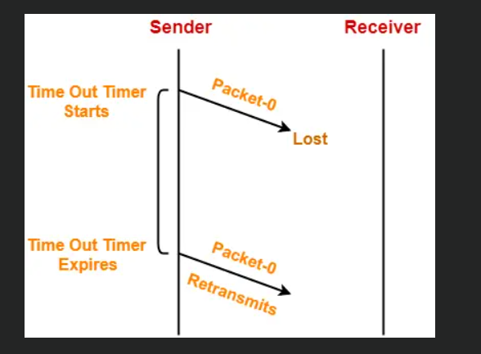
1. Problem of Lost Data Packet-
Time out timer helps to solve the problem of lost data packet.
After sending a data packet to the receiver, sender starts the time out timer.
If the data packet gets acknowledged before the timer expires, sender stops the time out timer.
If the timer goes off before receiving the acknowledgement, sender retransmits the same data packet.
After retransmission, sender resets the timer.
This prevents the occurrence of deadlock.

Slide 70
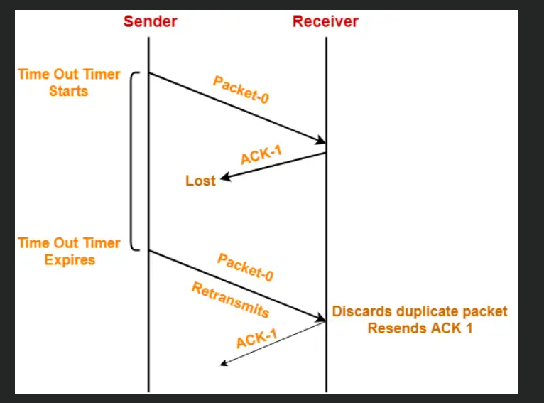
2. Problem of Lost Acknowledgement-
Sequence number on data packets help to solve the problem of delayed acknowledgement.
Consider the acknowledgement sent by the receiver gets lost.
Then, sender retransmits the same data packet after its timer goes off.
This prevents the occurrence of deadlock.
The sequence number on the data packet helps the receiver to identify the duplicate data packet.
Receiver discards the duplicate packet and re-sends the same acknowledgement.

Slide 71
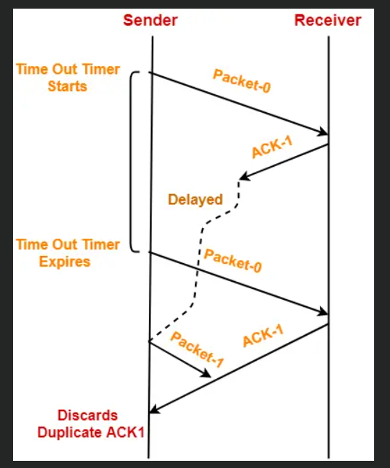
3.Problem of Delayed Acknowledgement
Sequence number on acknowledgements help to solve the problem of delayed acknowledgement.

Slide 72
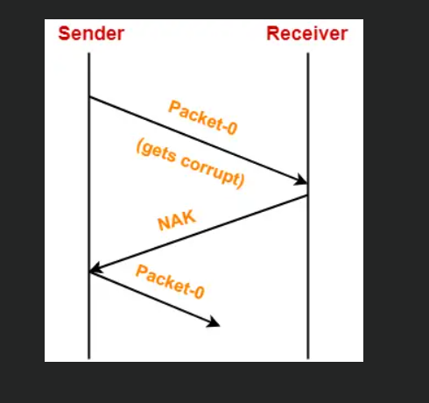
4.Problem of Damaged Packet-
If receiver receives a corrupted data packet from the sender, it sends a negative acknowledgement (NAK) to the sender.
NAK requests the sender to send the data packet again.

Slide 73
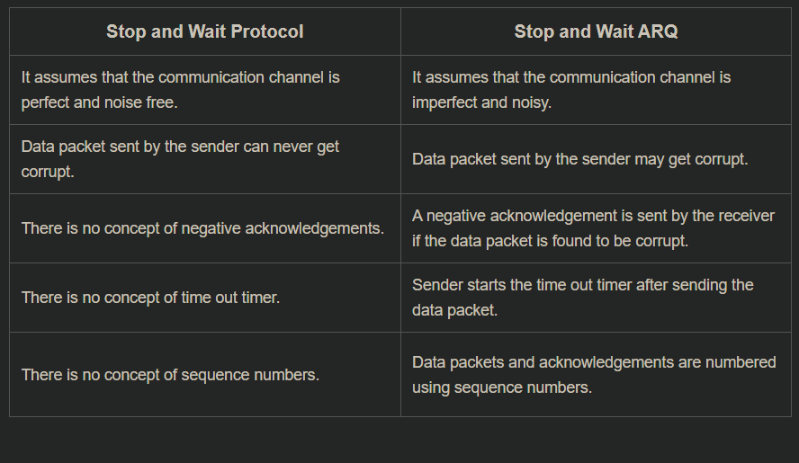

Slide 75
Go-Back-N ARQ
Go-Back-N ARQ works on the basis of sliding window protocol.
In Go-Back-N ARQ, N is the sender's window size. Suppose we say that Go-Back-3, which means that the three frames can be sent at a time before expecting the acknowledgment from the receiver.
It uses the principle of protocol pipelining in which the multiple frames can be sent before receiving the acknowledgment of the first frame. If we have five frames and the concept is Go-Back-3, which means that the three frames can be sent, i.e., frame no 1, frame no 2, frame no 3 can be sent before expecting the acknowledgment of frame no 1.
In Go-Back-N ARQ, the frames are numbered sequentially as Go-Back-N ARQ sends the multiple frames at a time that requires the numbering approach to distinguish the frame from another frame, and these numbers are known as the sequential numbers.

Slide 76
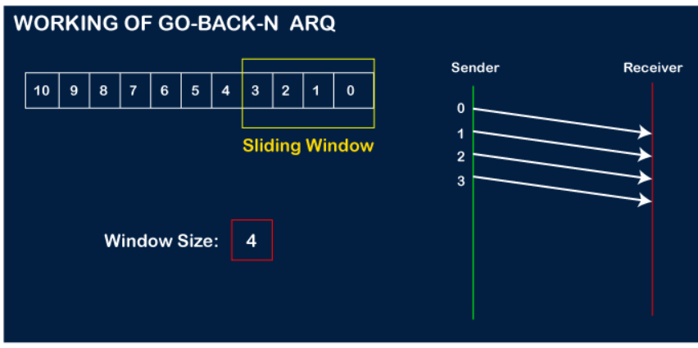
Working of Go-Back-N ARQ
Suppose there are 11 frames to be sent. These frames are represented as 0,1,2,3,4,5,6,7,8,9,10, and these are the sequence numbers of the frames. Mainly, the sequence number is decided by the sender's window size. But, for the better understanding, here running sequence numbers are shown, i.e., 0,1,2,3,4,5,6,7,8,9,10.
Let's consider the window size as 4, which means that the four frames can be sent at a time before expecting the acknowledgment of the first frame.
Step 1: Firstly, the sender will send the first four frames to the receiver, i.e., 0,1,2,3, and now the sender is expected to receive the acknowledgment of the 0th frame.

Slide 77
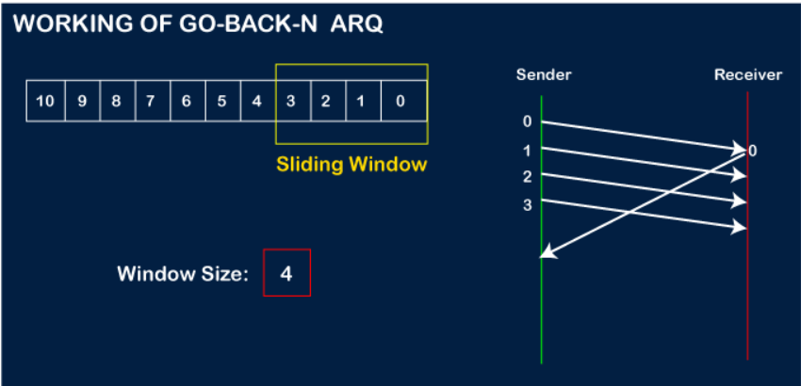
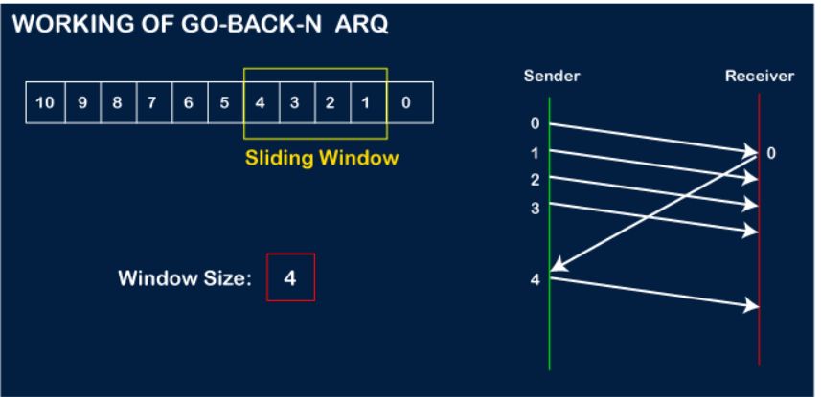

Slide 78
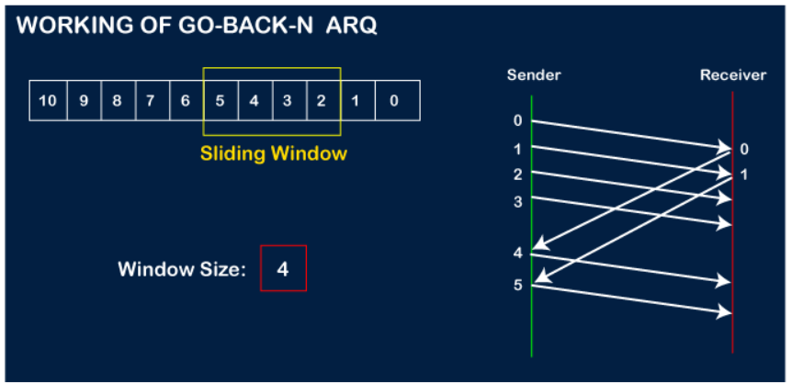
Now, let's assume that the receiver is not acknowledging the frame no 2, either the frame is lost, or the acknowledgment is lost. Instead of sending the frame no 6, the sender Go-Back to 2, which is the first frame of the current window, retransmits all the frames in the current window, i.e., 2,3,4,5.

Slide 79
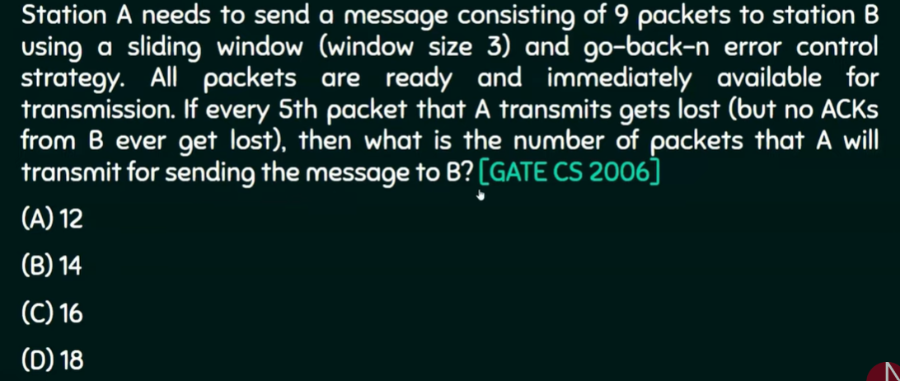

Slide 80
Selective Repeat ARQ
Selective Repeat ARQ is also known as the Selective Repeat Automatic Repeat Request. It is a data link layer protocol that uses a sliding window method. The Go-back-N ARQ protocol works well if it has fewer errors. But if there is a lot of error in the frame, lots of bandwidth loss in sending the frames again. So, we use the Selective Repeat ARQ protocol. In this protocol, the size of the sender window is always equal to the size of the receiver window. The size of the sliding window is always greater than 1.
If the receiver receives a corrupt frame, it does not directly discard it. It sends a negative acknowledgment to the sender. The sender sends that frame again as soon as on the receiving negative acknowledgment.

Slide 81
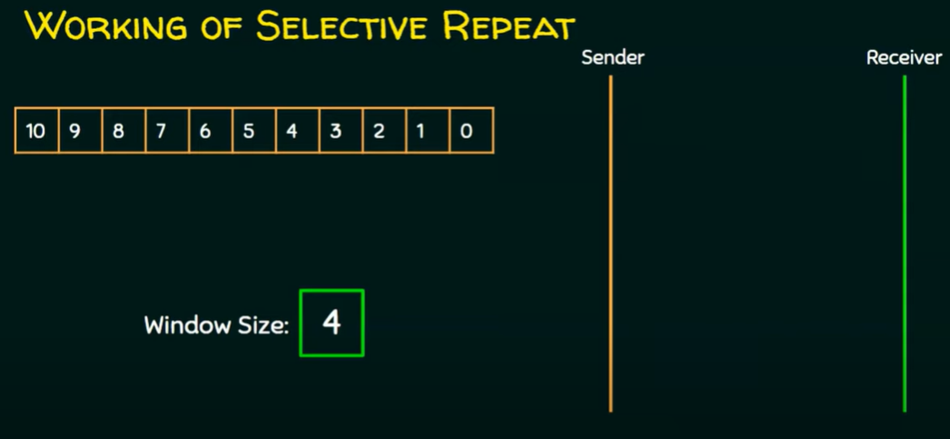

Slide 82
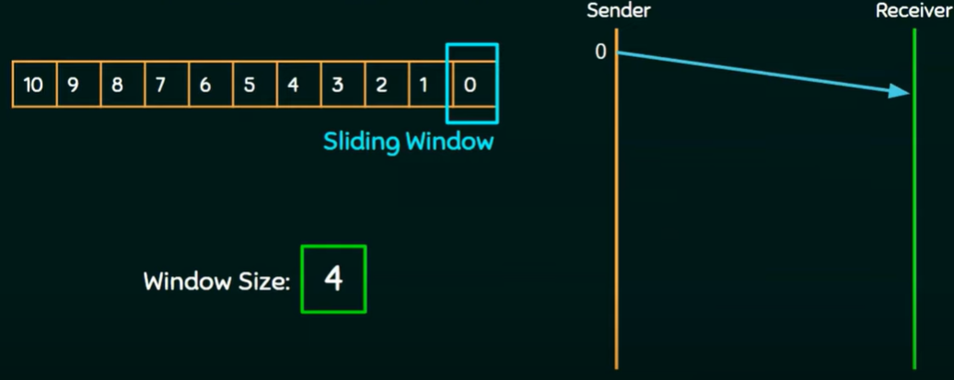
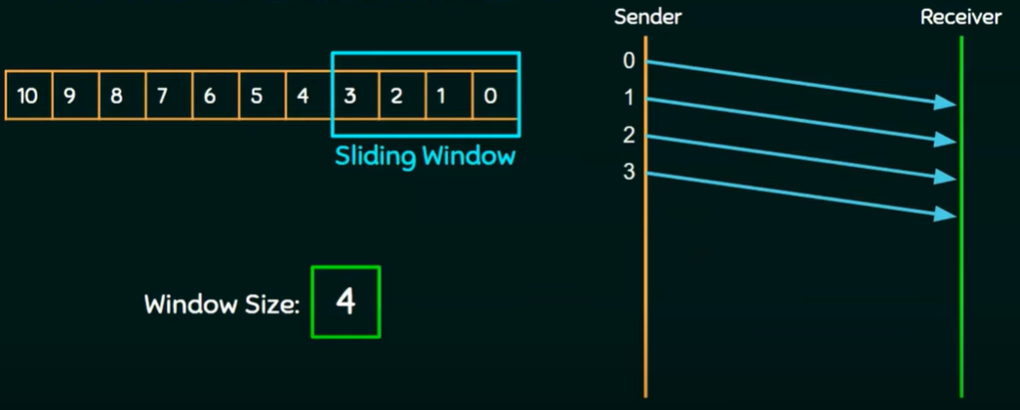

Slide 83
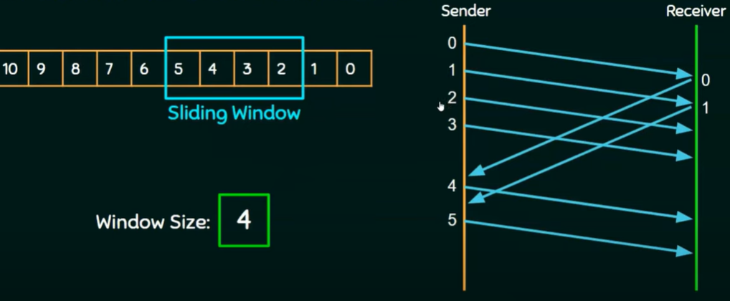
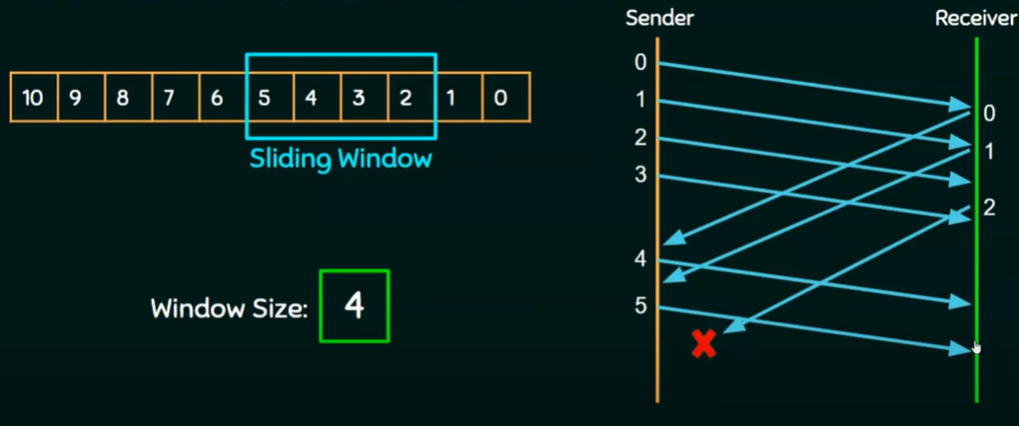

Slide 84
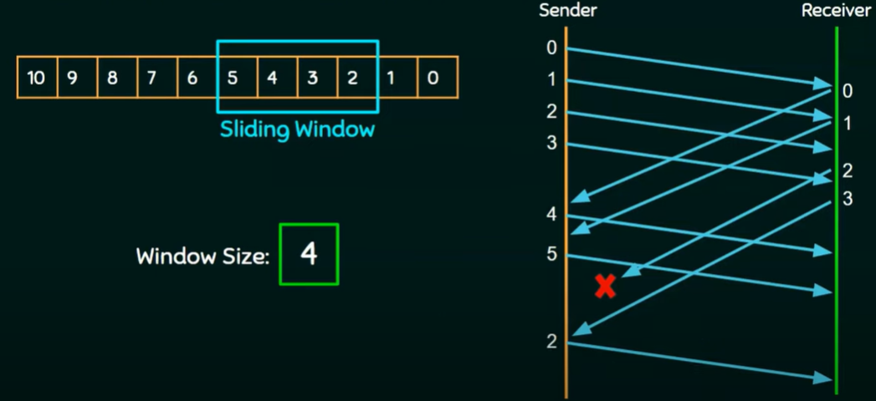

Slide 85
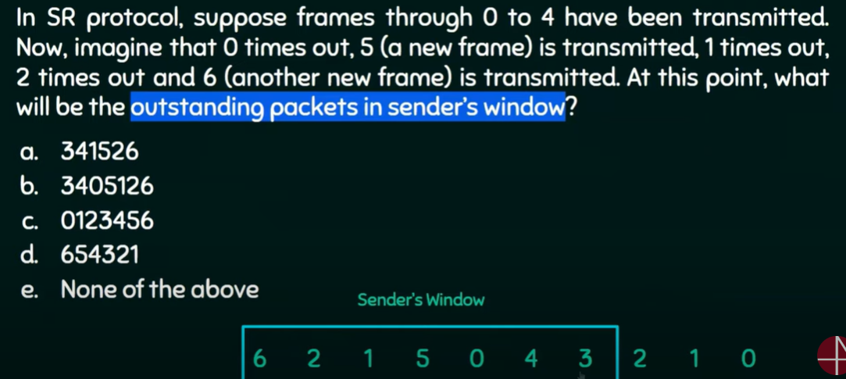

Slide 86
Piggybacking
The three protocols discussed are all unidirectional:
Data frames flow in only one direction although control information such as ACK and NAK frames can travel in the other direction.
In real life, data frames are normally flowing in both directions: from node A to node B and from node B to node A.
The control information also needs to flow in both directions.
A technique called piggybacking is used to improve the efficiency of the bidirectional protocols.
When a frame is carrying data from A to B, it can also carry control information about arrived (or lost) frames from B; when a frame is carrying data from B to A, it can also carry control information about the arrived (or lost) frames from A.

Slide 87
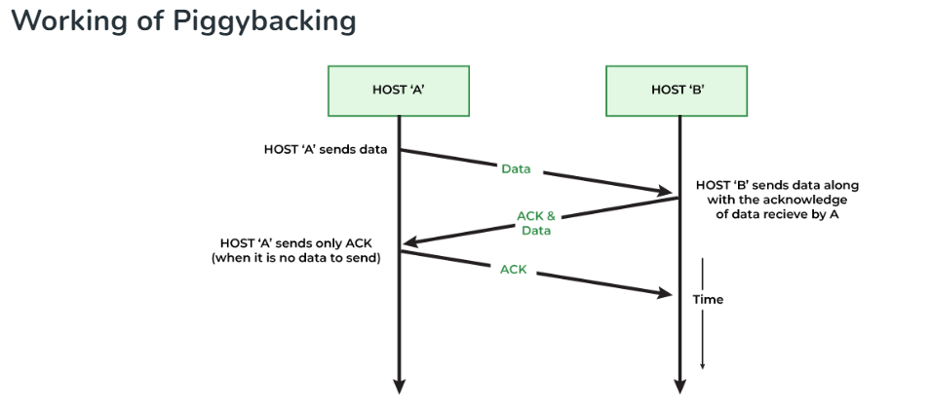
If Host A has both acknowledgment and data, which it wants to send, then the data frame will be sent with the ack field which contains the sequence number of the frame.
If Host A contains only one acknowledgment, then it will wait for some time, then in the case, if it finds any data frame, it piggybacks the acknowledgment, otherwise, it will send the ACK frame.
If Host A left with only a data frame, then it will add the last acknowledgment to it. Host A can send a data frame with an ack field containing no acknowledgment bit.

Slide 88

Multiple Access Protocol
When a sender and receiver have a dedicated link to transmit data packets, the data link control is enough to handle the channel.
Suppose there is no dedicated path to communicate or transfer the data between two devices. In that case, multiple stations access the channel and simultaneously transmits the data over the channel. It may create collision and cross talk. Hence, the multiple access protocol is required to reduce the collision and avoid crosstalk between the channels.

Slide 89
RANDOM ACCESS/ Contention Methods
In this protocol, all the station has the equal priority to send the data over a channel. one station cannot depend on another station nor any station control another station. Depending on the channel's state (idle or busy), each station transmits the data frame. However, if more than one station sends the data over a channel, there may be a collision or data conflict. Due to the collision, the data frame may be lost or changed.
Two features give this method its name
First, there is no scheduled time for a station to transmit. Transmission is random among the stations. That is why these methods are called random access.
Second, no rules specify which station should send next. Stations compete with one another to access the medium. That is why these methods are also called contention methods.

Slide 90
ALOHA
It is designed for wireless LAN (Local Area Network) but can also be used in a shared medium to transmit data. Using this method, any station can transmit data across a network simultaneously when a data frameset is available for transmission.
Types of ALOHA
Pure ALOHA
Slotted ALOHA

Slide 91

Pure ALOHA
The original ALOHA protocol is called pure ALOHA. This is a simple, but elegant protocol. The idea is that each station sends a frame whenever it has a frame to send. However, since there is only one channel to share, there is the possibility of collision between frames from different stations.

Slide 92
A collision involves two or more stations. If all these stations try to resend their frames after the time-out, the frames will collide again.
To avoid collisions stations has to wait for some random time. i.e back –off time (TB).The randomness will help avoid more collisions.
Pure ALOHA has a second method to prevent congesting the channel with retransmitted frames. After a maximum number of retransmission attempts Kmax a station must give up and try later.

Slide 93

Slotted ALOHA
Slotted Aloha divides the time of shared channel into discrete intervals called as time slots.
Any station can transmit its data in any time slot.
The only condition is that station must start its transmission from the beginning of the time slot.
If the beginning of the slot is missed, then station has to wait until the beginning of the next time slot.
A collision may occur if two or more stations try to transmit data at the beginning of the same time slot.

Slide 94
Carrier Sense Multiple Access (CSMA)
To minimize the chance of collision and, therefore, increase the performance, the CSMA method was developed. The chance of collision can be reduced if a station senses the medium before trying to use it. CSMA is based on the principle "sense before transmit" or "listen before talk.“
CSMA Methos
1- Persistent Method
Non – Persistent Method/ 0-persistent
P – Persistent Method

Slide 95



Slide 96
1-Persistent
The 1-persistent method is simple and straightforward. In this method, after the station finds the line idle, it sends its frame immediately (with probability 1).
Non-persistent /0 -persistent
a station that has a frame to send senses the line. If the line is idle, it sends immediately. If the line is not idle, it waits a random amount of time and then senses the line again.
p-Persistent
The p-persistent approach combines the advantages of the other two strategies. It reduces the chance of collision and improves efficiency.

Slide 97


Transmission Delay:
The time taken to transmit a packet from the host to the transmission medium is called Transmission delay.
Propagation delay:
After the packet is transmitted to the transmission medium, it has to go through the medium to reach the destination. Hence the time taken by the last bit of the packet to reach the destination is called propagation delay.

Slide 98
Carrier Sense Multiple Access with Collision Detection (CSMA/CD)
Check if the sender is ready to transmit data packets.
Check if the transmission link is idle.
Transmit the data & check for collisions.
The sender transmits its data on the link. CSMA/CD does not use an ‘acknowledgment’ system. It checks for successful and unsuccessful transmissions through collision signals. During transmission, if a collision signal is received by the node, transmission is stopped. The station then transmits a jam signal onto the link and waits for random time intervals before it resends the frame. After some random time, it again attempts to transfer the data and repeats the above process.
If no collision was detected in propagation, the sender completes its frame transmission and resets the counters.

Slide 99


Slide 100
Carrier Sense Multiple Access with Collision Avoidance (CSMA/CA)
In a wireless network, much of the sent energy is lost in transmission. We need to avoid collisions on wireless networks because they cannot be detected.
Carrier sense multiple access with collision avoidance (CSMA/CA) was invented for this network.
CSMA/CA works with these three strategies:
Interframe space
Contention window
Acknowledgments

Slide 101
Inter-Frame Space (IFS): When a station finds the channel busy it senses the channel again, when the station finds a channel to be idle it waits for a period of time called IFS time. IFS can also be used to define the priority of a station or a frame. Higher the IFS lower is the priority.
Contention Window: It is the amount of time divided into slots. A station that is ready to send frames chooses a random number of slots as wait time.
Acknowledgments: The positive acknowledgments and time-out timer can help guarantee a successful transmission of the frame.

Slide 102


